Slide 1
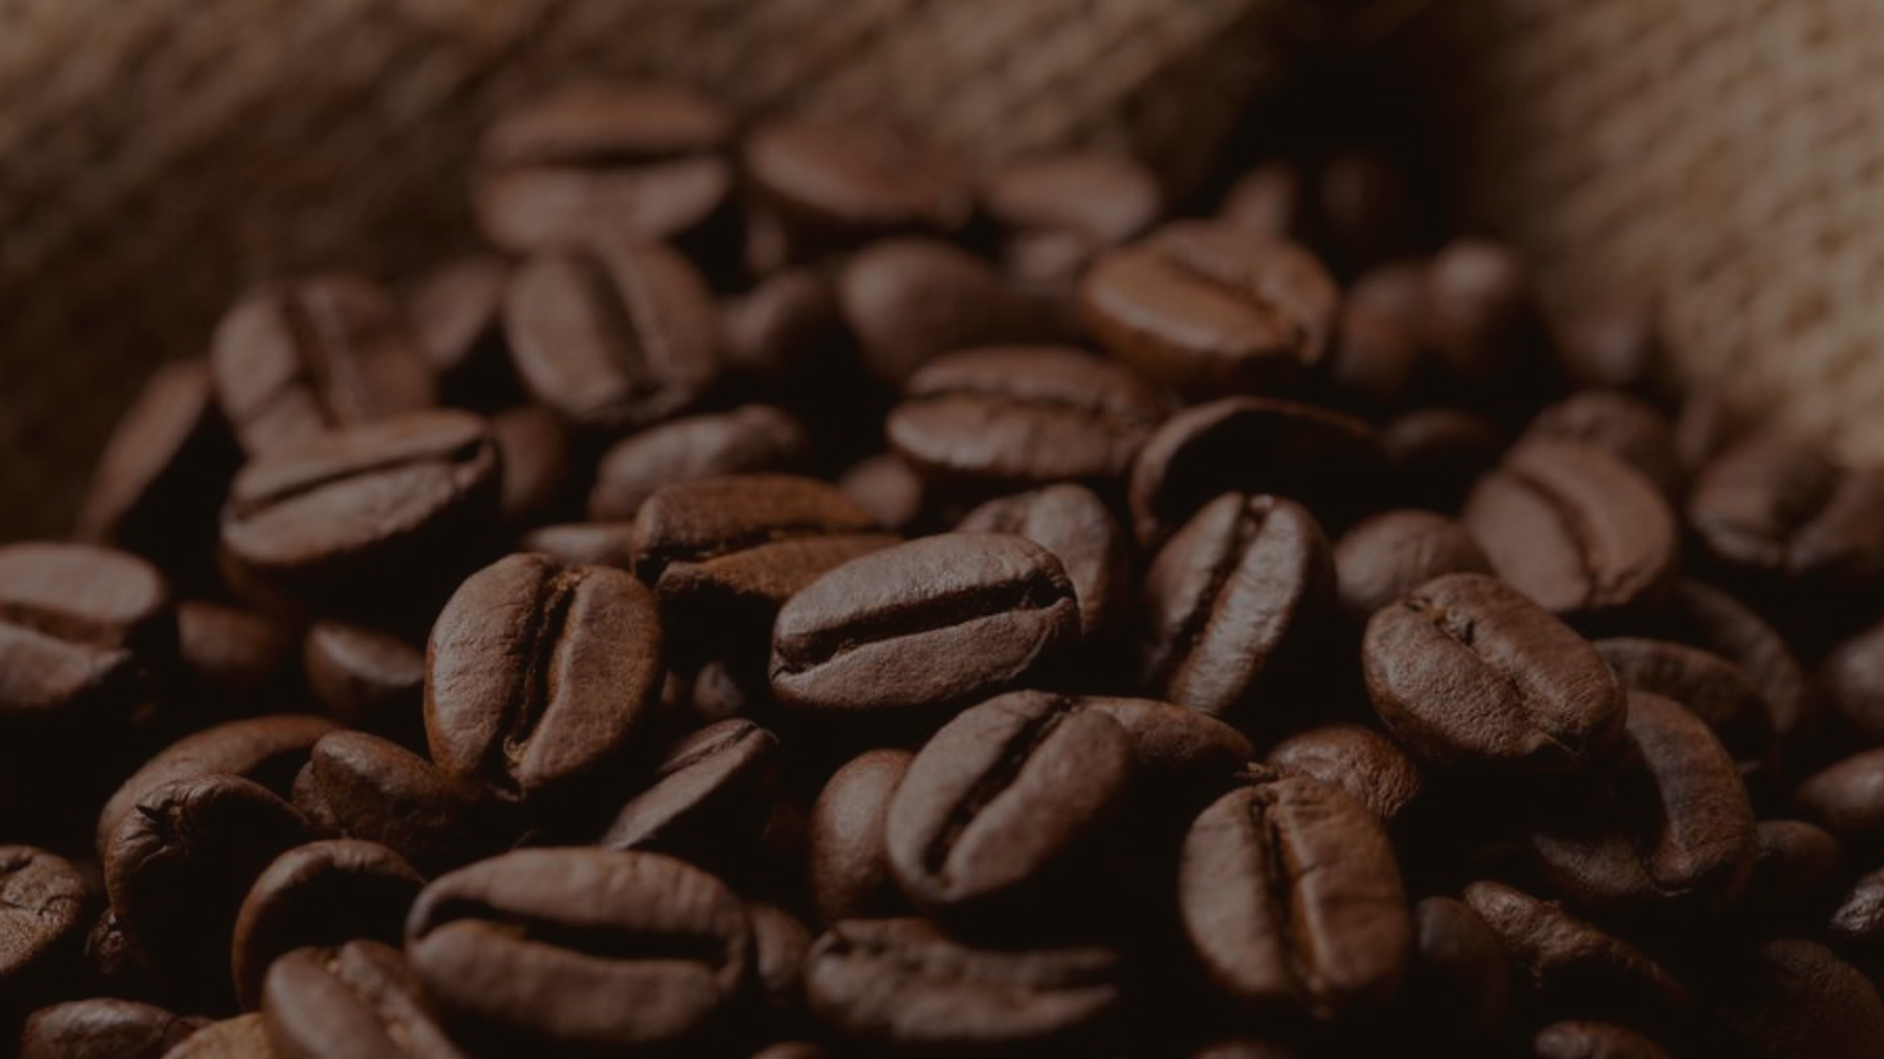

Coffee Sale Analysis

Slide 2
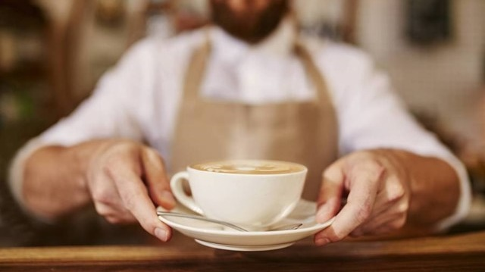
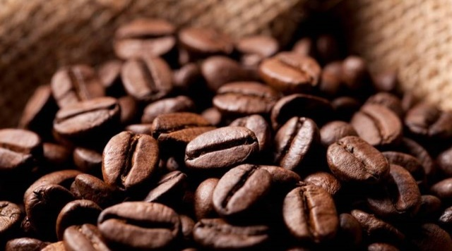
The Big
Buzz of
coffee
coffee consumption is a dynamic and integral part of global culture and economy,
The United States is a major consumer, with Americans drinking an average of 3.1 cups per day.

Slide 3

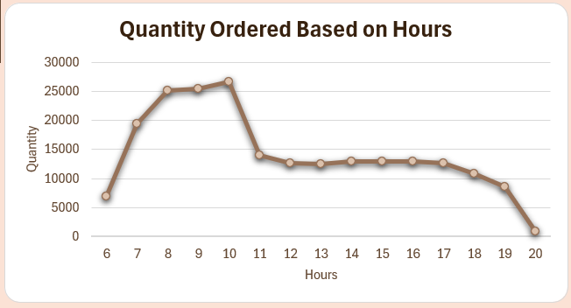
Peak Hours
Hours
Peak
8:00 AM,
9:00 AM,
10:00 AM
Non-Peak
11:AM – 7:00 PM

Slide 4
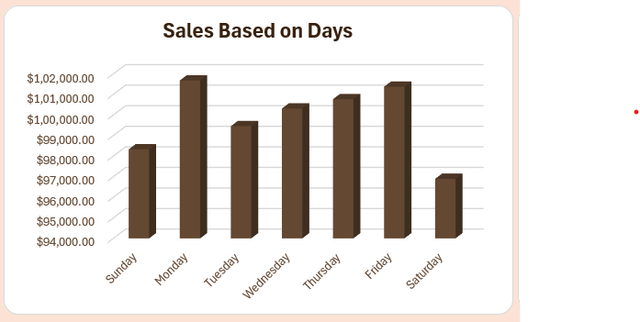
Days
---------------------------------------------------------------------------------------------------------------------------
Performing
Days
Monday
Friday
Non - Performing
Days
Saturday
Sunday

Slide 5
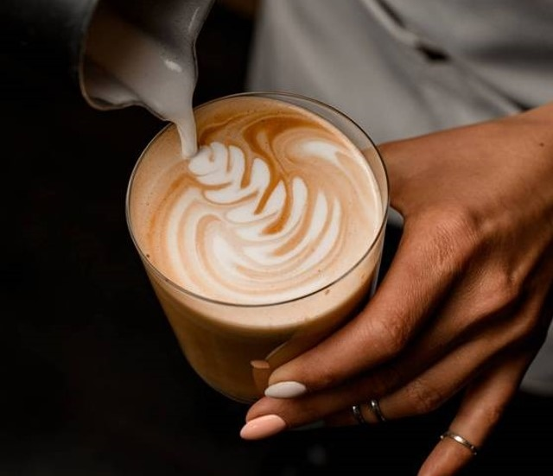
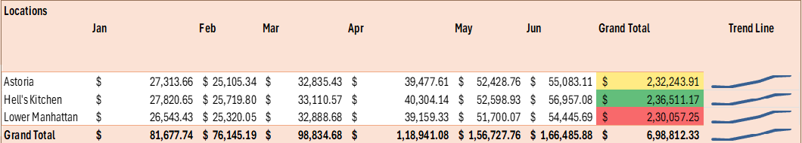
Month Over Month ----------------------------------------------------------

Slide 6
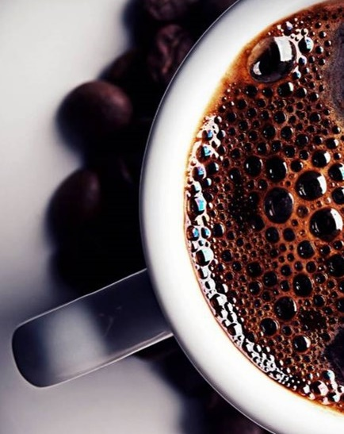
Insights
Peak Hours
The Peak hours are 8:00 AM to 10:00 AM. More Customers Visit in These Hours. We Should have to Focus on From 11:00 AM to 7:00 PM.
Performance
Monday & Friday are Best Performing Days with Highest Number of Sales.
But the Saturday & Sunday are Word Performing Days.
We can Give the Discount on these Particular Days.
Top Products
Barista Espresso
Brewed Chai Tea
Hot Chocolate
Gourmet Brewed Coffee
Theses are the Best-Selling Products. We can add more Categories in these Products
Because People Love theses Products

Slide 7
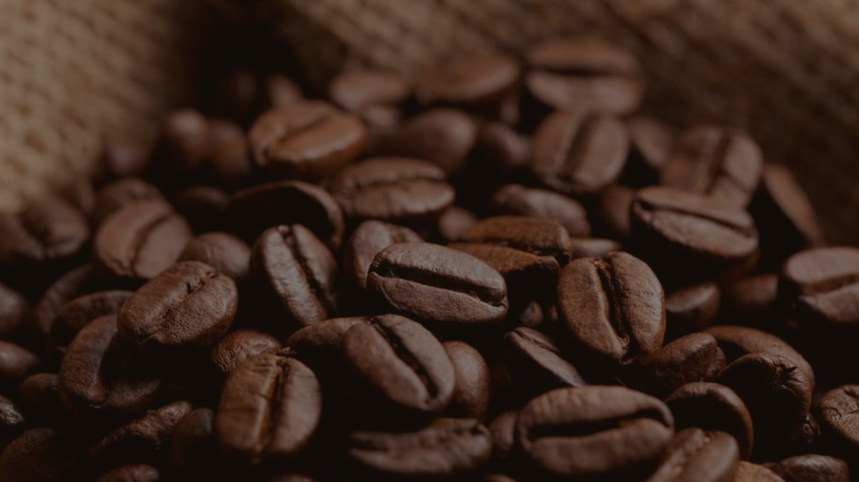

Thank you
Contact Me
Kamal Kumar
kamaljangir795@gmail.com
8725920612

